Slide 1
Bayesian Inference Approach
NC 812/ESD 812
Ref: Leveraging Spatio-Temporal Redundancy for RFID Data Cleansing, Chen et al, SIGMOD 2010

Slide 2
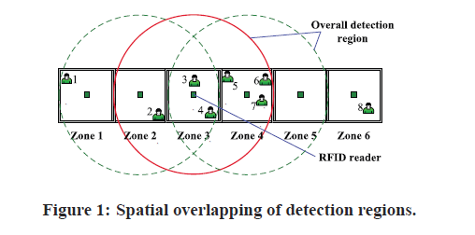
Redundancy

Slide 3
Bayes’Theorem
Bayesian inference is a statistical inference technique that estimates the probability of a hypothesis (x) based on observations (y).
Bayesian inference shows that posterior probability is proportional to the multiplication of likelihood and a-priori probability, which can be represented as p(x|y) ∝ p(y|x)p(x).

Slide 4
What is Bayes’ Theorem?
The Bayes’ Theorem states the conditional probability of an event given another.

Slide 5
Bayes’ Theorem
A box has three coins; a fair coin, a two-headed coin, and a two tailed coin. You are asked to pick one coin at random, look at only one side and guess whether it will have head or tail for the other side.
What is the optimum decision strategy for this game?
Solution: Essentially you need to determine which is the coin that you have drawn looking at one side. Since it is a guess, there is always a chance that an error may be made. Goal is to minimize this error.

Slide 6
Example
Let us define the outcome (whatever is seen on the coin drawn z_{H} and z_{T}). The three coins are indicated as H_{F} (fair coin), H_{H} (two headed coin), H_{T} (two tailed coin).
What you need to determine is

Slide 7
Example
P(H_{F}|z_{H})=1/3
P(H_{H}|z_{H})=2/3
P(H_{T}|z_{H})=0
P(H_{F}|z_{T})=1/3
P(H_{H}|z_{T})=0
P(H_{T}|z_{T})=2/3
Thus, head is observed, your best bet is to guess that it was the two-headed coin that was drawn.
This is also referred to as the maximum likelihood estimate. It minimizes the probability of error.

Slide 8
Maximum likelihood Estimator
Idea behind the maximum likelihood estimate is that we choose the estimate what has higher a posteriori probability. E.g. in the earlier case, if head is shown, we choose the answer which has highest a posteriori probability.
A maximum likelihood estimator is an estimator that maximizes the posteriori probability (hence minimizes the error).
Why is this important? Where can you apply a MLE? Does it really work?

Slide 9
Problem Formulation
Suppose there are m zones and n objects in our monitoring environment, each zone with a reader mounted in the zone center.
Let o_{i} represent the object with ID i. For each o_{i}, its location is represented by a random variable h_{i}.
Therefore, a possible distribution of n objects in m zones can be denoted as an instance of the random vector Hˆ = (h₁, h₂,...,h_{n}). h_{i} represents the zone ID where object o_{i} is in. For example h₁ = 2 denotes that object o₁ is in zone 2 in the current instance.

Slide 10
Problem Formulation
For the reader in zone j, the raw data (0 or 1) it receives from the RFID tag of object o_{i} is denoted as z_{ij} .
The raw data matrix for each complete scan from m readers can be represented as an n × m matrix Z = [z_{ij} ]. Thus the Bayes’ theorem can be represented as shown next, where posteriori probability P(Hˆ |Z) denotes the posterior probability of location vector Hˆ given the raw data Z, and a valid hypothesis means the hypothesis satisfies all constraints:
P(Hˆ |Z)=0 : Hˆ is not valid
P(Hˆ |Z) > 0 : Hˆ is valid
P(Hˆ₁|Z) > post(Hˆ₂|Z) : Hˆ1 is more likely than Hˆ₂

Slide 11
Notations

Slide 12
Posteriori Probabilities

Slide 13
Posteriori Probabilities
If z_{ij} = 1 in a raw data matrix and the actual location of object o_{i} is not in zone j, then z_{ij} is a false positive.
P(z_{ij} |h_{i}) reflects the corresponding likelihood, which is the probability that the reader in zone j reports the value of z_{ij} about object o_{i} given that object o_{i} is actually in the zone with ID h_{i}. Furthermore, p(h_{j} ) denotes the prior probability that the object o_{j} is in the zone with the ID of h_{j} . The apriori probability can be interpreted as the assumed distribution before acquiring the RFID raw data.

Slide 14
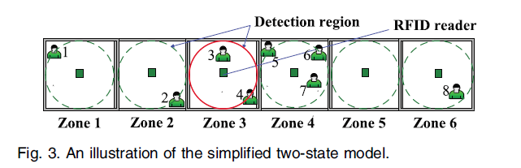
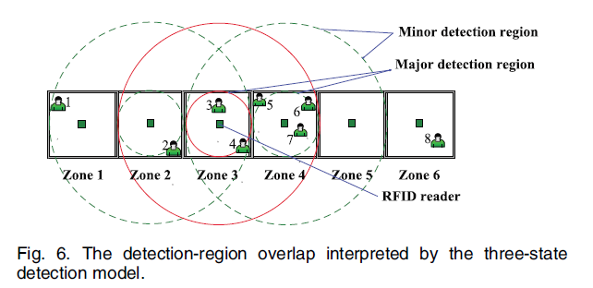
RFID Reader Range

Slide 15
n State model
The overall detection region of an RFID reader can be divided into several subregions, each of which corresponds to a zone associated with a unique read rate. For a four-state model, the highest read rate is say, x. The first state (counted with the increase of the detection distance) holds a read rate of x, the second state keeps a read rate of 2x/3, the third state maintains a read rate of x/3, and the fourth state eventually has a read rate of zero.
For a specific reader, the n-state detection model, each correlated zone is assigned a distinct read rate according to its distance to this reader. In particular, the simplest model in the family of the n-state detection model is the two-state model, where an identical read rate is assumed in the overall detection region of each reader.

Slide 16
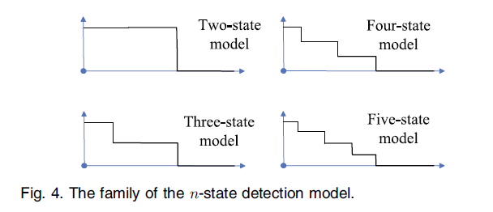
n State model

Slide 17
n State model
The number of states depend on how zones are divided in overall detection regions of RFID readers.
An n-state model, implies that every group which has 2(n- 1)+2 = 2n - 3 zones that correlate with each other (assuming that all the zones are in a one-dimensional distribution).
For example, if it is known as prior knowledge that one object can be read simultaneously by up to five readers, we have to choose n = 4 to incorporate the correlation among every five successive zones.

Slide 18
3 State Model
Consider a case where, one reader can only detect its own zone and the two neighboring zones. For a particular reader, there are three distinct location-based states of an object: in the same zone as the reader, in the neighboring zones, and in all the other zones.
To capture this correlation, n=3 is chosen, resulting in three-state detection model, where the overall detection range of a reader is divided into two subregions, the major detection region, the minor detection region, and the zero read rate region.
Denoting the mean value of the read rate in the major detection region as r_{major} and the mean value of the read rate in minor detection region as r_{minor}, the estimate of the likelihood using the three-state model can be represented as follows:

Slide 19
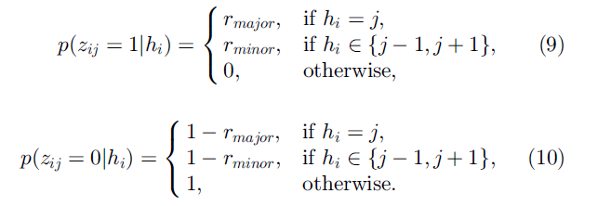
Likelihood

Slide 20
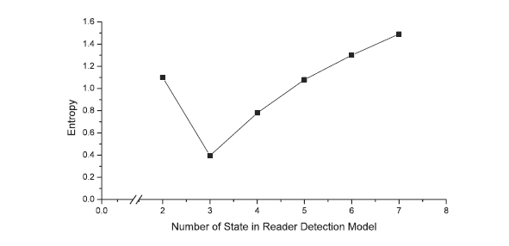
Entropy/Uncertainty

Slide 21
Reader Placement and Entropy
Likelihood changes with 2-D, 3-D RIFD reader. Placement should be done to improve readability and reduce the associated entropy.
Several Techniques available to achieve this optimization.

